Slide 1

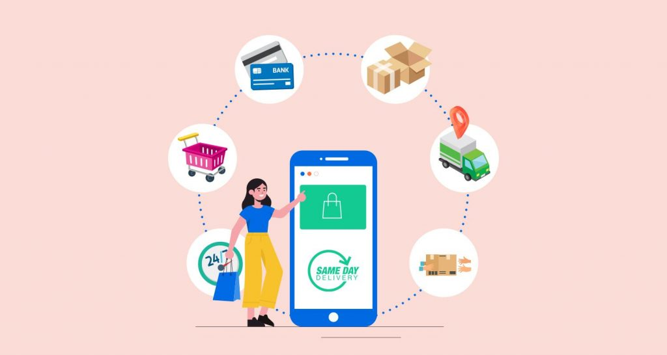
The Purchase Habits of Online Shoppers
A Project Presented by:
Pratishtha Theeng
Ellen Liu
Sarah Burnap
Renz Carl Supnet
Jordan Dreyer

Slide 2


GOAL OF THIS PROJECT
Analyze visitor behavior on an e-commerce website.
Understand which factors, influence online purchasing decisions.
Help e-commerce businesses identify high-value visitors and optimize conversion strategies.
Build and optimize a model with accuracy of 75% or higher for efficient data storage, access, and querying.
Ultimately, to predict the likelihood of a purchase based on session data.

Slide 3

Dive into the Deep End
The Online Shopping Behavior dataset tracks visitor interactions on an undisclosed e-commerce site.
It tracks:
Page Types: Administrative, Information, Product-related, etc.
Website Analytics: Bounce Rates, Exit Rates, Page Values, etc.
Categorical: Special Day, Month, Operating Systems, etc.
Target Variable: Revenue
Dataset Details: 12,330 Sessions, 84.5% (10,422 Sessions) no purchase made, 15.5% (1,908 Sessions) with a purchase made

Slide 4
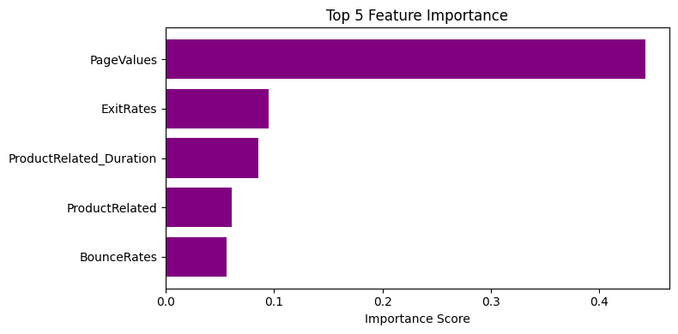
What Drives Online Shopping?
Page Values shows the largest impact on whether a sale will happen.
This figure is the average of the total amount of pages visited within a session.
Because of this we were prompted to focus into the page types visited and time spent there.
Notes:
Information on Importance Score:
Feature Importance is a technique performed by Random Forest to indicate how the features contribute to the model’s predictive performance. It is calculated by measuring the decrease in a node’s impurity, meaning the mixture of the data in that node, when the features are split and averages by all trees in the forest. The higher the importance score, the more impact that feature will have on the model’s predictions.
Fun Facts!:
All importance scores throughout the features equal to 1!

Slide 5
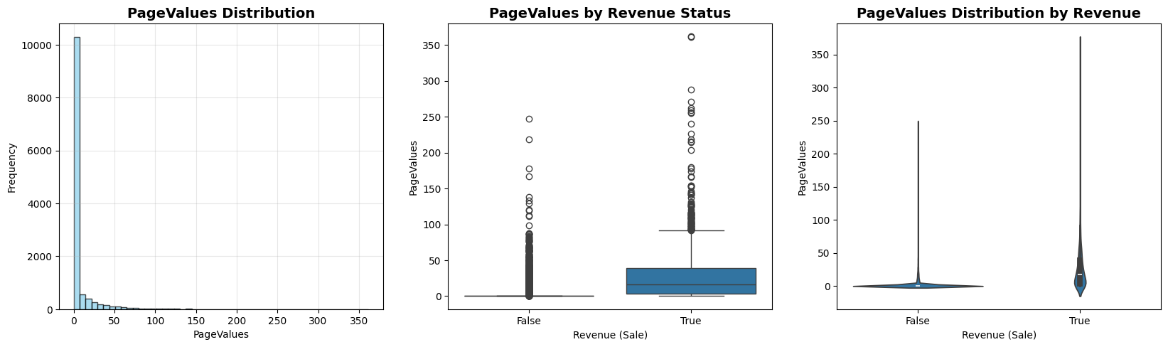
A Deeper Look into Page Values
We found total page visits under 50 times showed the most consistent promise of a purchase being made.
Our base Random Forest model predicted that PageValues of 40 have an 85.4% probability of sale, and all values beyond 50 have an 85.6% probability of a sale.
There is a 49% correlation between PageValues and a positive Sale happening.

Slide 6
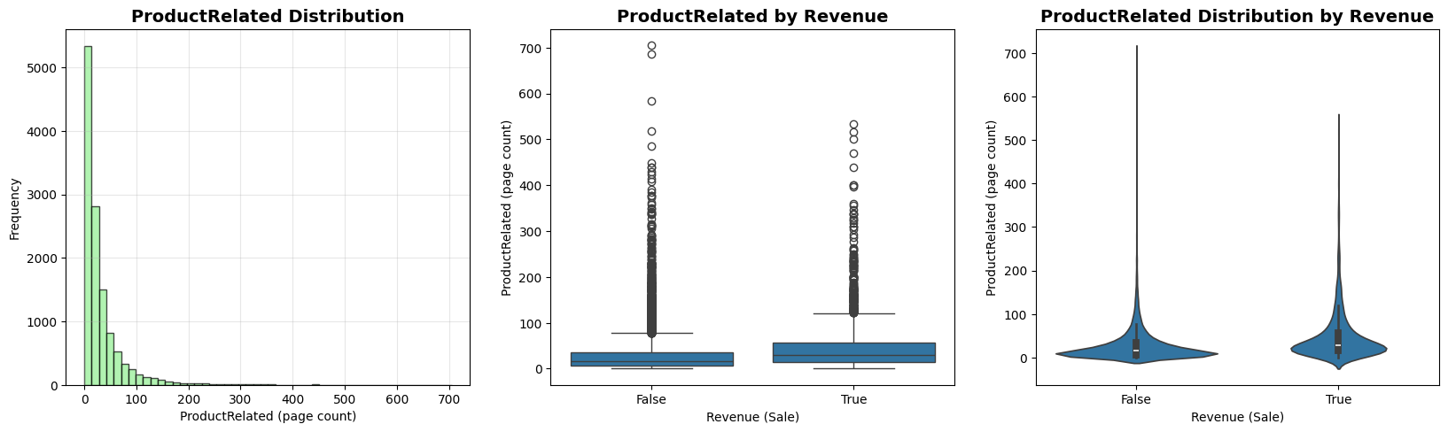
How About Product Pages?
Visiting a product related page around 10 times or less shows a positive correlation to a sale!
Our base model predicted that visiting a Product Related Page 5 times has a 14% probability of sale, and visiting 30 times has an 11.4% probability of a sale.
There is a 16% correlation between Product Page visits and a positive Sale happening.

Slide 7
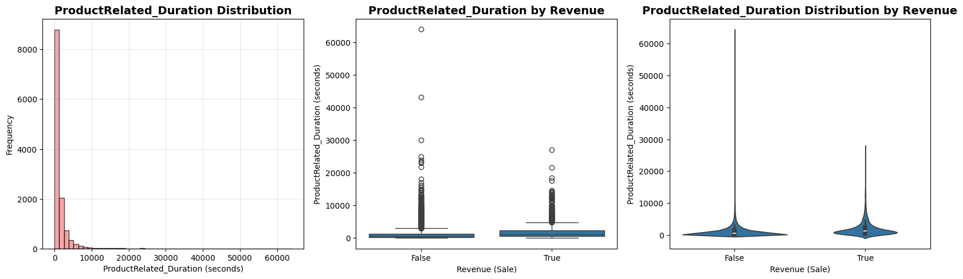
Does the Time Spent Matter?
Why yes, it does! Visiting a product related page and sticking around for around 100 seconds or 1.6 minutes shows a strong indication of a sale!
Our base model predicted that being on a Product Related Page for 30 seconds has a 12.9% probability of sale, and staying for 300 seconds has an 13.1% probability of a sale.
There is a 15% correlation between time spent on a Product Page and a positive Sale happening.

Slide 8




MACHINE LEARNING MODELS EXPLORED
RANDOM FOREST
TENSOR FLOW KERAS
KNN

Slide 9

What is KNN?
Why it didn’t work:
KNN has a heightened sensitivity to class imbalances
Susceptible to excessive noise in models
KNN
RANDOM
Also known as K-Nearest Neighbors is a simple but powerful Machine Learning algorithm skilled with both classification and regression.
It classifies new data points based on the majority class of its nearest neighbor in the training data!
KNN Base Model:
83% accuracy
98% precision for No Sales, .01% precision for Sales

Slide 10

What is Tensor Flow/Keras?
Why it didn’t work:
Tensor Flow and Keras need extensive hyperparameter tuning
On top of being a slower option, it is also likely to be overfit
It’s operations in nature creates a black-box neural network
This model ended up being uneven
TENSOR FLOW
TensorFlow is an open-source machine
learning platform developed by Google. It
enables building, training, and deploying
neural network models that can learn
complex patterns from large amounts of data.
TensorFlow is widely used for deep learning
applications due to its flexibility, scalability,
and support for efficient computation across
different hardwares.
KERAS
Keras is a high-level neural network library
written in Python that runs on top of
TensorFlow. It simplifies building, training and
experimenting with deep learning models by providing an easy-to-use, intuitive interface.
Keras helps quickly design complex neural
networks without needing extensive coding..
TFK Base Model:
86% accuracy
92% precision for No Sales, 56% precision for Sales

Slide 11
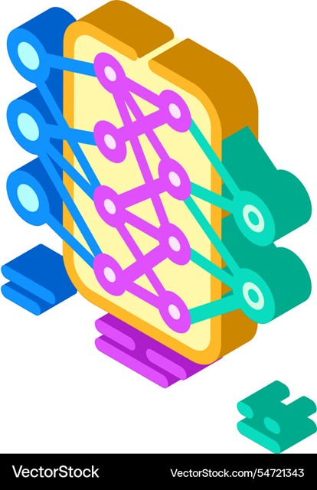
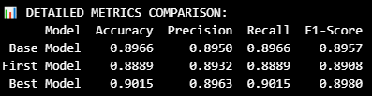
What is Random Forest?
RANDOM FOREST
Why it worked:
Multiple decision trees that combine to reduce overfitting
Uses different data samples for each tree
Has built in weight options to handle class imbalances
Random Forest is an ensemble machine learning method that creates many decision trees using random samples of data and features.
Each tree makes a prediction, and the final result is determined by averages across all trees. This approach improves accuracy, reduces overfitting, and handles complex data well, making it effective for classification and regression models.
TESER FLOW
RF Base Model:
89% accuracy
93% precision for No Sales, 66% precision for Sales
Notes:
If you remember at the beginning when we talked about our dataset, you’ll remember that it is heavily skewed to no sales. While we don’t know the exact reasons as to why there aren’t as many sales, we need to consider that we don’t know the website the data was based off of , the year that the data was collected, or even what products or industry the sales were based on. Regardless of these facts, we still had to accept that we had few sales to make our predictions on. We ran a total of 3 models before settling on the Best Model for us.

Slide 12
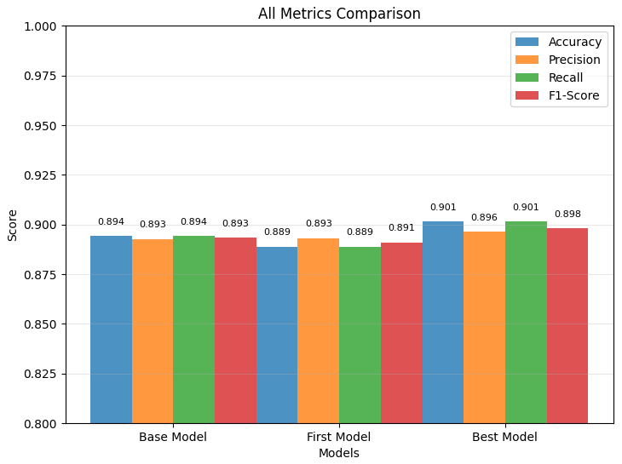
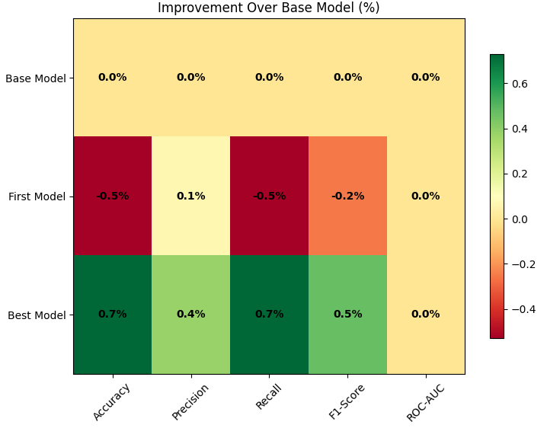
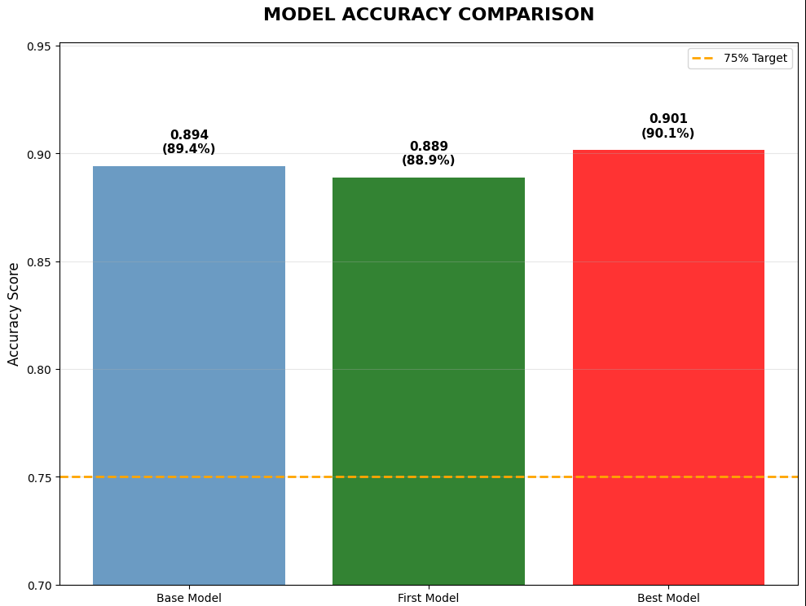
Our Model
We achieved our 90% accuracy model with Random Forest. We optimized it with less Estimators, deeper Depth, more sample Splits, increased Random States, and keeping the Weight Balanced.
Notes:
The class imbalances between sales and no sales brought a unique challenge to our analysis. In our Final model, we have the highest accuracy score, but our classes are also better supported. Our optimized model provides 72% precision for sales compared to the 66% precision provided in our base model. With our sales features being the underdogs here, we need to support them more! Overall, our optimized model preforms better in every category compared to the other 2 tested and even the other models we tried.

Slide 13
Final Model Analysis
After optimizing our final model, we re-ran our analysis and predictions!
Here’s how it turned out:
Page Values: Predictions dropped from 85.6% to 79%
Product Duration: Predictions dropped from 13.1 % to 11.4%
Product Pages: Predictions dropped from 14.4% to 10.4%
Why did it change?
Why is it good?
Better Calibration
More Reliable Confidence
Not Overfit
Averages out extreme predictions
Favors generalizations
More honest about Uncertainty
More Moderate, stable predictions
Traded overconfident predictions for better accuracy
Higher accuracy + lower max probabilities = Better Model
Increased trustworthy predictions
Better real-world performance
Notes:
With our new and improved optimized model, we re-ran our analysis and predictions! While we received a drop in the all predictions: Page values: dropped about 6.6%, Product Duration: dropped around 1.7%, Product Pages: Dropped approximately 4%, that is okay! We are happy to see these drops because with the higher accuracy score it means that our model is better calibrated, it provides more reliable confidence, is not prone to be overfit like our base model is, it averages out the harsh extremes, and favors generalizations. This means that our predictions are more honest with its uncertainty, making the predictions more moderate and stable. It traded its overconfidence for better accuracy which combined with lower max probabilities equals to a better model with trustworthy predictions leading to a more accurate real-world performance.

Slide 14




CONCLUSION
It’s clear that the way you interact with a website impacts your propensity to make a purchase. The evidence is heavier towards how many pages you visit and how long you stay on that page. Our model can scale to be used to aid in marketing tactics for businesses to increase the likelihood of a sale with great accuracy and trust. Future applications can be used in conjunction with psychological sales tactics to increase the occurrences of sales to provide more data for increased optimization.

Slide 15

THANK YOU

